Slide 1
Information Governance, Data Retention and Other Best Practices in M365
O365 User Group
July 13, 2023

Slide 2
Agenda
What is Information Governance?
What is Data Retention?
What is Information Lifecycle Management (ILM)?
Why should you care?
M365 Features/Functionality

Slide 3
What is Information Governance?
ARMA: The overarching and coordinating strategy for all organizational information. It establishes the authorities, supports, processes, capabilities, structures, and infrastructure to enable information to be a useful asset and reduce liability to an organization, based on that organization’s specific business requirements and risk tolerance.

Slide 4
What is Information Governance?
OpenText: Information Governance is the development of a decision and accountability framework that defines acceptable behavior in the creation, valuation, use, sharing, storage, archiving, and deletion of information. It encompasses the policies, standards, processes, metrics, and roles guiding the efficient and effective use of information for an organization to realize its objectives.

Slide 5
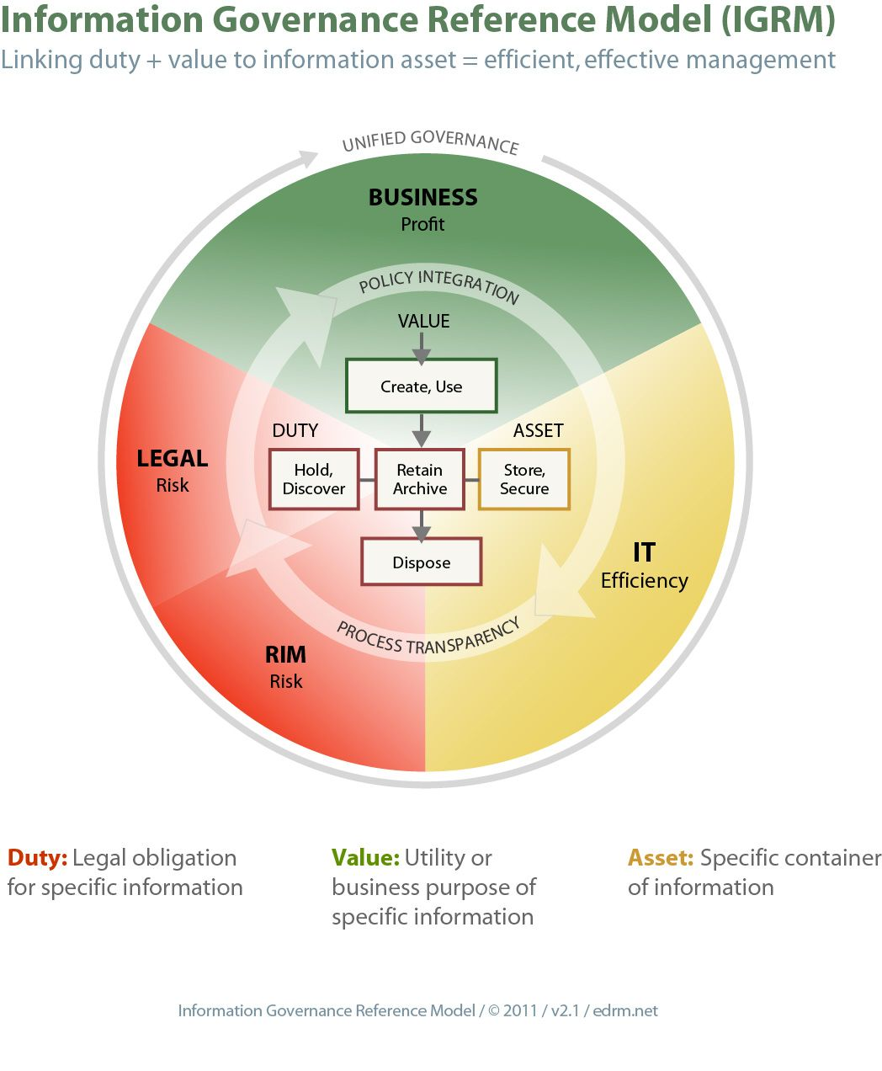
Information Governance Reference Model

Slide 6
What is Information Governance?
Implementing a governance framework
What needs to be done and how should it be done
Establishing governance roles and responsibilities
Who is responsible for doing what
Conducting regular compliance assessments
Are we doing what we should be doing

Slide 7
What is Data Retention?
Storage of an organizations data for legal, regulatory or business reasons
Also called Records Retention but expanded to include not just records but all data or information in an organization
Must identify legal and regulatory requirements and determine data retention requirements off these
Then overlay with business needs and adjust retention periods taking into account the level of risk an organization is comfortable with
Will active and inactive data/information be treated differently

Slide 8
What is Information Lifecycle Management (ILM)?
Understanding the stages of the information lifecycle
Create/Use, Retain/Archive, Legal Holds/Discovery, Dispose
Store and keep Secure throughout
Implementing appropriate actions and policies for each stage
Creation and capture
Classification and organization
Storage and retention
Archiving and deletion

Slide 9
Why You Should Care
Data Leaks – not if, but when Data Breaches That Have Happened in 2023 So Far - Updated List (tech.co)
Reputation
Lost business
Fines/Settlements
Legal Sanctions – legal holds not applied properly
eDiscovery Costs – reviewing non-responsive data
Storage Costs – “storage is cheap”…not really
Regulatory Fines – keeping data too long or not long enough

Slide 10
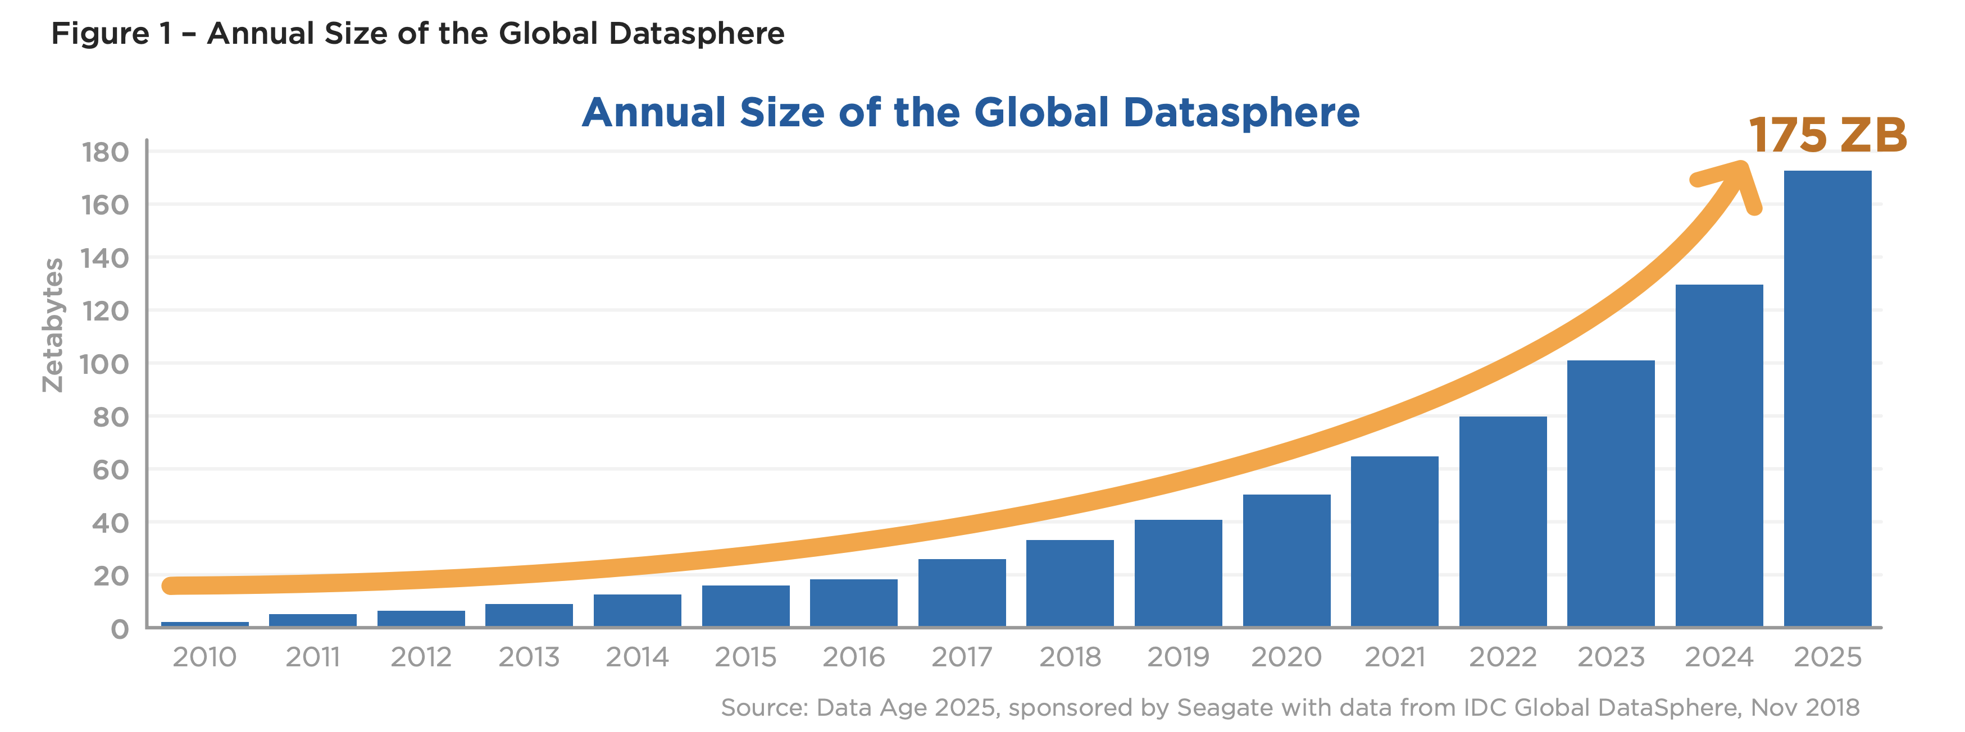
Why You Should Care

Slide 11
Best Practices – Data Mapping
What information do you have and how long do you need to hold onto it
Where are the “Crown Jewels”
Sensitive data subject to higher scrutiny/regulations (Personally Identifiable Information, Credit Card Information, Health Information, etc.)
Business critical data needed to operate
Data required for legal/regulatory compliance
Where is the information located
File Share, SharePoint, OneDrive, Teams, 3rd party tools, databases, etc.

Slide 12
Best Practices – Information Classification
Classify information when created/received into pre-defined categories
Content Types
Metadata
Retention Labels
Sensitivity Labels
Automate this process when possible
Use those categories to then implement storage, security/access, legal hold, and disposition processes

Slide 13
Best Practices – Security
Who has access to information and is it secure at rest and in transit
Least Privilege rule – only grant access to people who need it and then only at the level of access they need (Read, Contribute, Full Control, Site Collection Admin, SharePoint/Teams Admin, Global Admin, etc.)
Use Distribution Lists that are automatically updated if possible so that as people come and go from departments, the access manages itself
Use SharePoint Groups when possible so you can update access in one location versus having to go into each Document Library/List if permissions are broken
Consider turning off sharing in sites so that only owners can grant access instead of members sharing out files
Consider policies for External Sharing (ex. allowed for Teams and OneDrive but not SharePoint)

Slide 14
Best Practices – Records Management
Is information being classified with Retention when created
Is information disposed of when past retention/ usefulness
What method is used for disposing of information in a timely fashion once past retention

Slide 15
Best Practices – Auditing
Do you have established/published policies that are reviewed at least annually
Are your employees regularly trained on policies, at least annually and during the onboarding process
Do you audit your systems for compliance to policies

Slide 16
Best Practices - Continuous Improvement
Reviewing and updating data retention and information governance policies
Incorporating feedback and lessons learned
Staying informed about regulatory changes and updates

Slide 17
M365 Features/Functionality - Purview
Combines the former Azure Purview and Microsoft 365 compliance solutions and services together into a single brand.
These solutions help your organization to:
Gain visibility into data assets across your organization
Enable access to your data, security, and risk solutions
Safeguard and manage sensitive data across clouds, apps, and endpoints
Manage end-to-end data risks and regulatory compliance
Empower your organization to govern, protect, and manage data in new, comprehensive ways

Slide 18
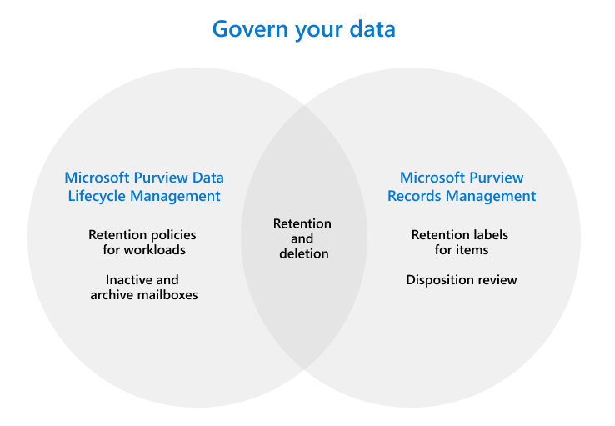
Purview

Slide 19
Purview
Risk and Compliance Solutions
Protect sensitive data across clouds, apps, and devices
Know your data (sensitive information types, trainable classifiers, data classification)
Protect your data (sensitivity labels)
Prevent data loss (information to monitor, where to monitor, action to take when match is found)
Manage data lifecycle
Retention labels and policies (file plan, disposition review, and tracking)

Slide 20
Purview
Unified Data Governance Solutions
Create an up-to-date map of your entire data estate that includes data classification and end-to-end lineage
Identify where sensitive data is stored in your estate
Create a secure environment for data consumers to find valuable data
Generate insights about how your data is stored and used

Slide 21
Purview
Licensing Microsoft 365 guidance for security & compliance - Service Descriptions | Microsoft Learn
Across the board E5 seems to be the least common denominator

Slide 22
M365 Features/Functionality - Syntex
Microsoft Syntex is a content understanding, processing, and compliance service that uses intelligent document processing, content AI, and advanced machine learning to automatically and thoughtfully find, organize, and classify documents in your SharePoint libraries.
Being positioned as future of Records Management tools inside M365.
Discover new insights and take action.

Slide 23
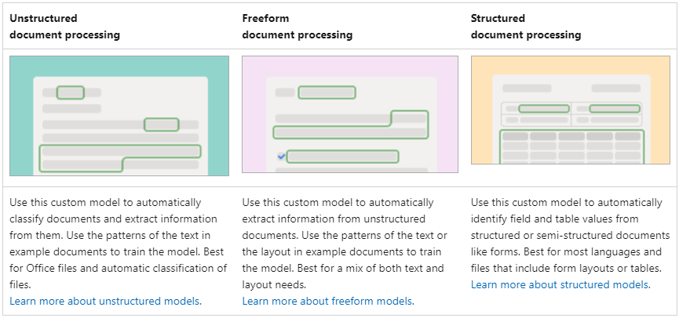
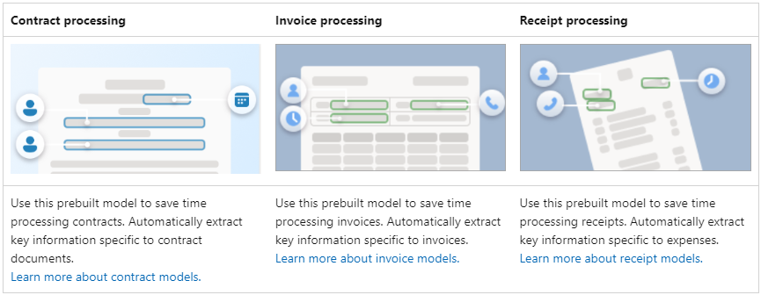
Syntex
CUSTOM
Intelligent Content Processing Solution
Models to Read, Tag, Extract and Classify
Functionality found in 3rd party tools like KnowledgeLake, OpenText, and Kofax
Rules to trigger business processes like Alerts, Emails, and Filing
PREBUILT

Slide 24
Syntex
Content Assembly
Generate repetitive documents quickly with modern templates
Contracts, statements of work, service agreements, letters of consent, sales pitches
Microsoft Word (.docx/.doc)
Template and document associated with ONE document library – create again to use in another document library

Slide 25
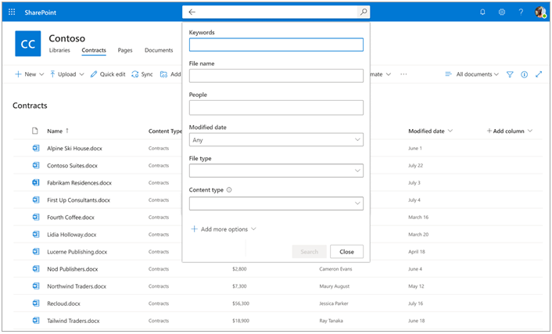
Syntex
Content Query
Specific metadata-based queries on SharePoint document libraries
OOTB: Keywords, File name, People, Modified date, File Type, Content Type
Custom site columns – especially useful if model running on the library

Slide 26
Syntex
Co-Pilot
Assistive AI technology for documentation
Quickly generating summary of information, key points or milestones
Lifecycle management through analytics, security and automated retention (Retention labels and Sensitivity labels)
eSignature
Annotation
Translation
Summarization

Slide 27
Syntex
Licensing Licensing for Microsoft Syntex - Microsoft Syntex | Microsoft Learn
Only to customers currently licensed for Microsoft 365 F1, F3, E3, A3, E5, A5, Office 365 F3, E1, A1, E3, A3, E5, A5, Microsoft 365 Business Basic, Business Standard, Business Premium, or SharePoint Online K, Plan 1, or Plan 2.
Per-User: as of 7/1/23 no longer available for purchase
Pay-as-you-go Pay-as-you-go services and pricing for Microsoft Syntex - Microsoft Syntex | Microsoft Learn

Slide 28
M365 Features/Functionality - Copilot
Today, we are bringing the power of next-generation AI to work. Introducing Microsoft 365 Copilot — your copilot for work. It combines the power of large language models (LLMs) with your data in the Microsoft Graph and M365 apps to turn your words into the most powerful productivity tool on the planet. – March 2023
Integrated into apps like Word, Excel, PowerPoint, etc.
Business Chat – surface information and insights
Natural language prompts
Microsoft combines power of LLMs with GPT-4, your data
in Microsoft Graph, and all the M365 apps

Slide 29
Copilot
Jumpstart Creativity – never start from a blank slate
Word/Outlook – first draft, save hours in writing, sourcing info, and editing time
PowerPoint – creates presentations with simple prompts using relevant data from existing documents like Word and Excel, generate images using DALL-E
Excel – analyze trends and create professional-looking data visualizations
Whiteboard/OneNote – generate and organize ideas, summarize content
Viva Learning – create personalized learning journey
Unlock Productivity
Email - Summarize long email threads, draft suggested replies
Teams – summary key decisions, where people aligned or
disagree, suggest action items in real time
Power Platform – automate repetitive tasks, create chatbots,
and go from idea to working app in minutes

Slide 30
Copilot
Early Access Program – invitation only May 2023
Semantic Index (E3 and E5)
Sophisticated map of personal and company data
Identifies relationships and makes connections
Conceptual map of information
Indexed in Microsoft Graph
Enhances search even without Copilot for E3/E5
Licensing – Not available yet
CAUTION – Data oversharing could be a problem with surfacing data that you’d rather keep secret!

Slide 31
Amber Roberts CIGO, ACP, MBA Amber.Roberts@Kiewit.com LinkedIn: linkedin.com/in/-amberroberts

